Slide 1
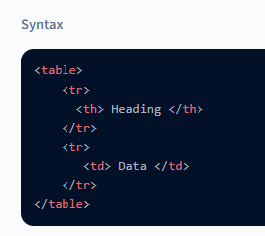
Tables in HTML are a collection of data organised in rows and columns, or a more complicated form tables are commonly used in data analysis, research, and communication.
To create a Table in HTML <table> tag is used which is the main container of the table.

Slide 2
<table>…..</table> tags represents an HTML table.
<th>….</th> tags is used to add a column heading in a column.
<tr>….</tr> tags represents a row in the table
<td>…..</td> tags are used to add data value in the column

Slide 3
<table>
<
th
>Name</
th
>
<
th
>Roll</
th
>
<
th
>Result</
th
>
<tr>
<td>Sudhir</td>
<td>101</td>
<td>Pass</td>
</tr>
<tr>
<td>Raja</td>
<td>102</td>
<td>Pass</td>
</tr>
<tr>
<td>
Sumit
</td>
<td>103</td>
<td>Pass</td>
</tr>
</table>
Name | Roll | Result
Sudhir | 101 | Pass
Raja | 102 | Pass
Sumit | 103 | Pass

Slide 4
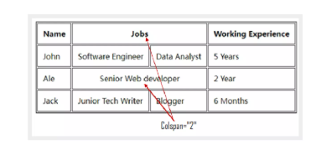
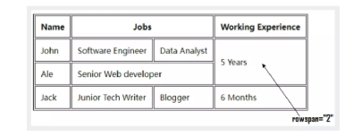
HTML table with Colspan
Colspan is an attribute which assigns multiple columns to a cell of a table. The number of columns depends on the value entered by you in colspan="" attribute.
HTML tables with Rowspan
Rowspan in table, works similar to the clospan for columns, but here, we assign multiple rows to a cell using an attribute rowspan="" .

Slide 5
<table border="1">
<tr>
<th>Name</th>
<th colspan="2">Jobs</th>
<th>Working Experience</th>
</tr>
<tr>
<td>John</td>
<td>Software Engineer</td>
<td>Data Analyst</td>
<td>5 Years</td>
</tr>
<tr>
<td>Ale</td>
<td colspan="2">Senior Web developer</td>
<td rowspan="2">2 Year</td>
</tr>
<tr>
<td>Jack</td>
<td>Junior Tech Writer</td>
<td>Blogger</td>
</tr>
</table>

